Slide 1
AFRICAN INSTITUTED CHURCHES
SEMINAR PAPER
TANGAZA UNIVERSITY COLLEGE
11-02-2021

Slide 2
LECTURE OUTLINE
INTRODUCTION
Meaning of the Term African Instituted Churches (AICs)
Typology of AICs
Factors behind the rise of AICs
Main characteristics of AICs
Contributions of AICs to African Christianity
Conclusion

Slide 3
TYPOLOGY OF AICs
Main typologies of AICs
Ethiopian/African/Nationalist
Zionist/Aladura/Spiritual/Roho/Apostolic/Prophet-healing/Prayer-healing
Messianic
African Pentecostal Churches
Other Typologies of AICs
-Witchcraft eradication movements
-Millennial movements
-Separatist/Schismatic movements

Slide 4
CHARACTERISTICS OF AICs
Pneumatological emphasis
Spiritual call of a prophet
Healing
Church as a community
Liturgy
Roles and status of women
Social-political engagement
Christology

Slide 5
Contribution of AICs to African Christianity
AICs are valid expressions of African Christianity
Inculturation of Christianity
Healing
Affirmation of women as founders of churches and participants
Composition of hymns
Ecclesiology
Rediscovery of the importance of the Holy Spirit
Form an important aspect of the spread and growth and spread of Christianity
Contributed to African Christian theology
Address existential needs of their members.

Slide 6
Online resources
http://www.scielo.org.za/scielo.php?script=sci_arttext&pid=S1017-04992014000300015
https://www.euppublishing.com/doi/abs/10.3366/swc.2004.10.2.205?journalCode=swc
https://www.researchgate.net/publication/326606499_THE_RELEVANCE_OF_AFRICAN_INDEPENDENT_CHURCHES_TO_THE_YORUBA_OF_SOUTH-WESTERN_NIGERIA/link/5b588899458515c4b2449a2b/download
http://www.internationalbulletin.org/issues/1979-02/1979-02-048-walls.pdf

Slide 7
RESOURCES-CONT.
file:///C:/Users/PROF~1.NJE/AppData/Local/Temp/69245-Article%20Text-145059-1-10-20110902.pdf
file:///C:/Users/PROF~1.NJE/AppData/Local/Temp/Peeters.pdf
https://repository.up.ac.za/bitstream/handle/2263/21579/017_Chapter16_p410-445.pdf?sequence=18&isAllowed=y
file:///C:/Users/PROF~1.NJE/AppData/Local/Temp/[13397877%20-%20Ethnologia%20Actualis]%20African%20Independent%20Churches%20in%20Zambia%20(Lusaka).pdf

Slide 8
CONCLUSION
Reflection
ORGANISATION OF African Instituted Churches
-formation-1978
-Concerned with inter-church relations
-Advocacy
-Poverty eradication
-HIV/AIDS prevention, management
-Realization of the Sustainable development goals
-Peace and conflict resolution
-Christian unity.

Slide 9
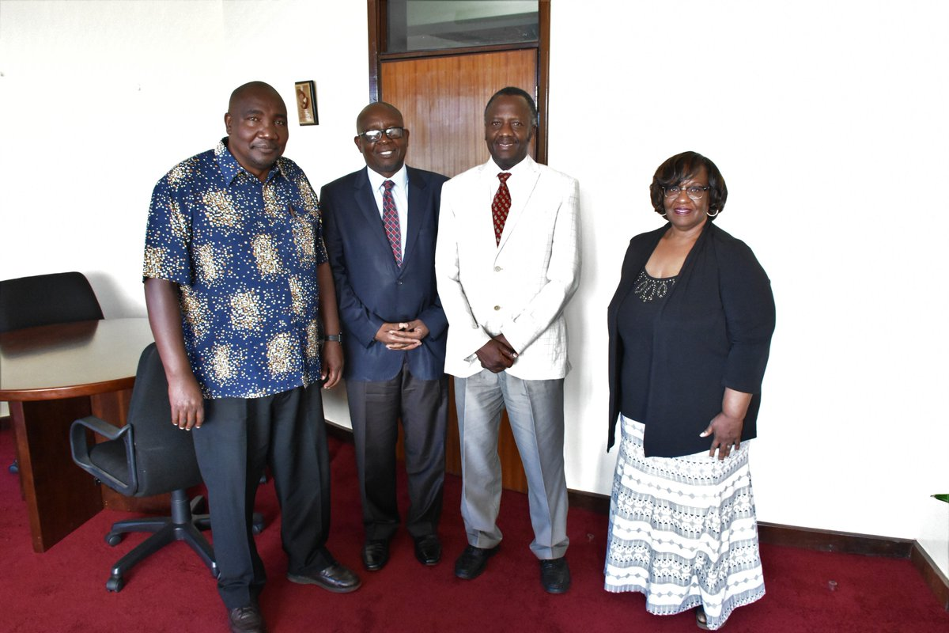
Image

Slide 10
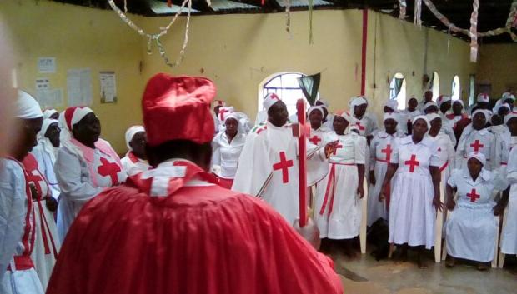
IMAGES OF AICS

Slide 11
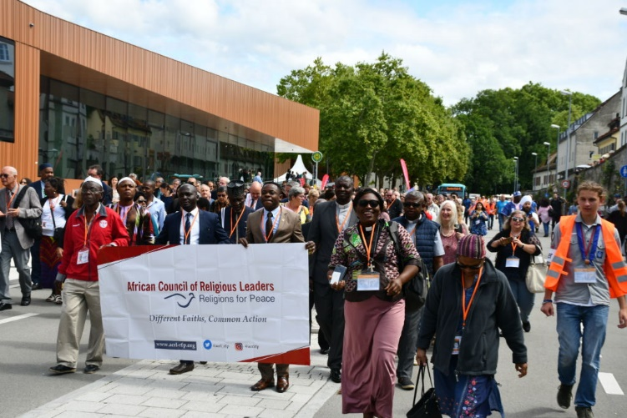
IMAGES CONT.

Slide 12
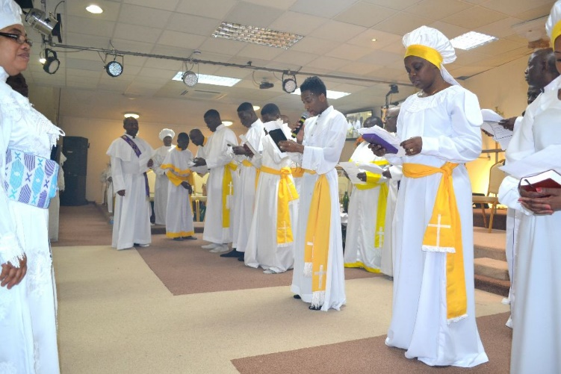
IMAGES

